Slide 1
Potion
Team. 함밤주
(고진호, 신지훈, 정연우)

Slide 2


Slide 3
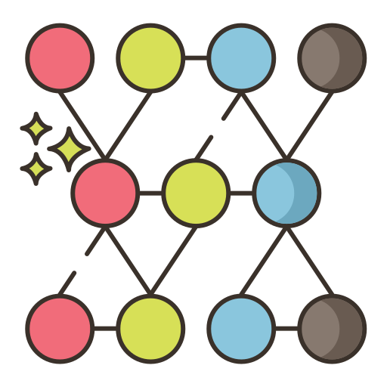

Slide 4



Slide 5


Slide 6



Slide 7


Slide 8


Slide 9



Slide 10
Deep
Learning
NLP
automatic
link recommendation
isEvolvedTo
Machine
Learning

